Slide 1
Section 3:
Comparison with
Current Method

Slide 2
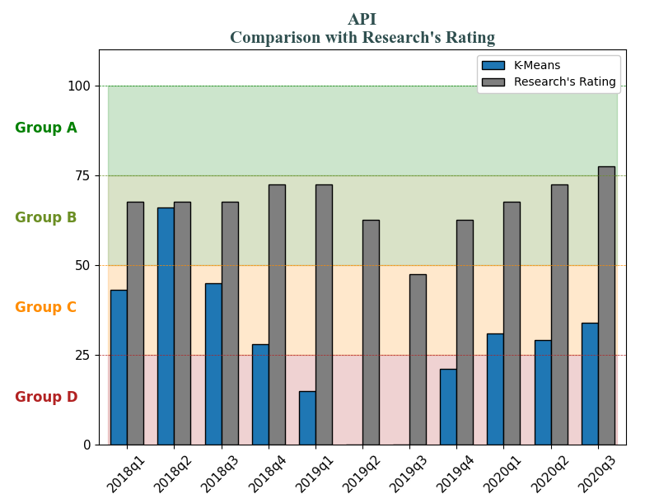
API dropped 50% in 2019q3

Slide 3
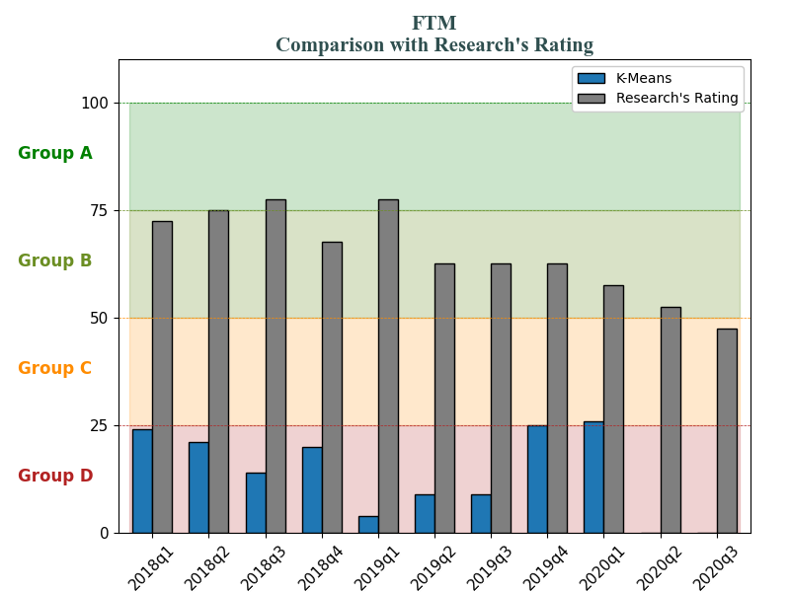
FTM dropped 90% in 2019q3

Slide 4
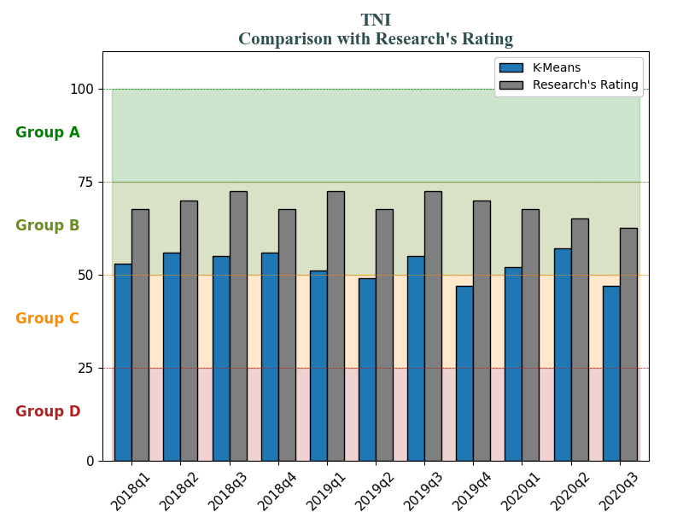
TNI dropped 75% in 2020q2

Slide 5
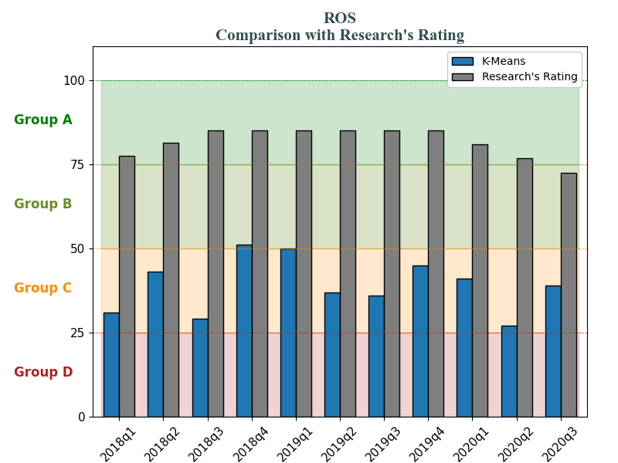
ROS dropped 70% in 2020q1

Slide 6
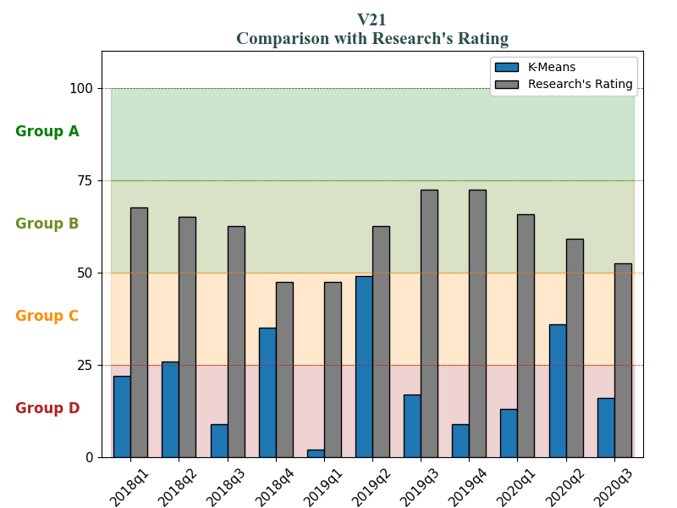
V21 dropped 75% in 2020q2

Slide 7
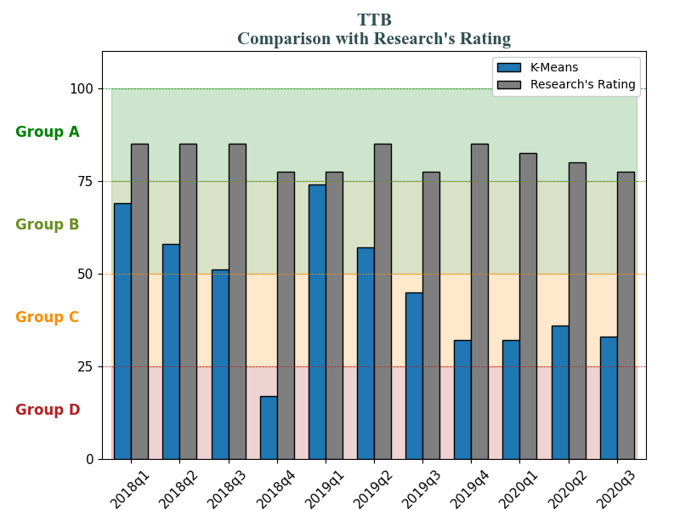
TTB dropped 75% in 2019q4

Slide 8
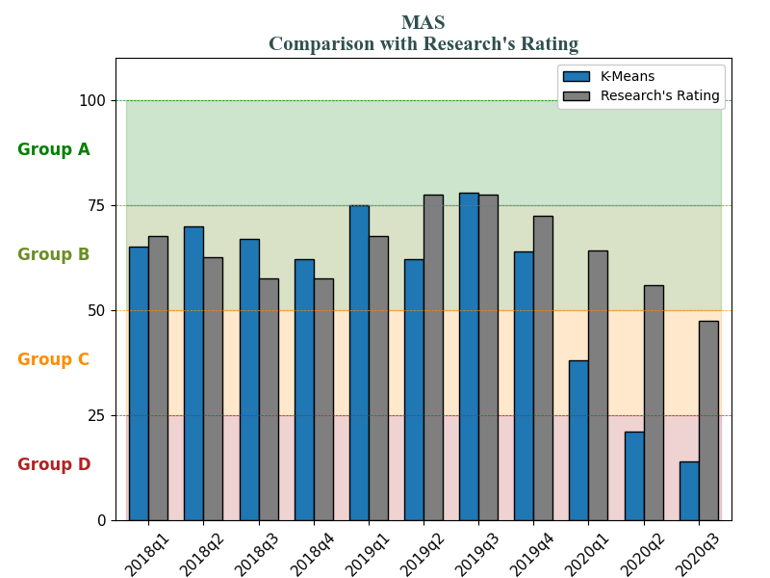
MAS dropped 50% in 2020q1

Slide 9
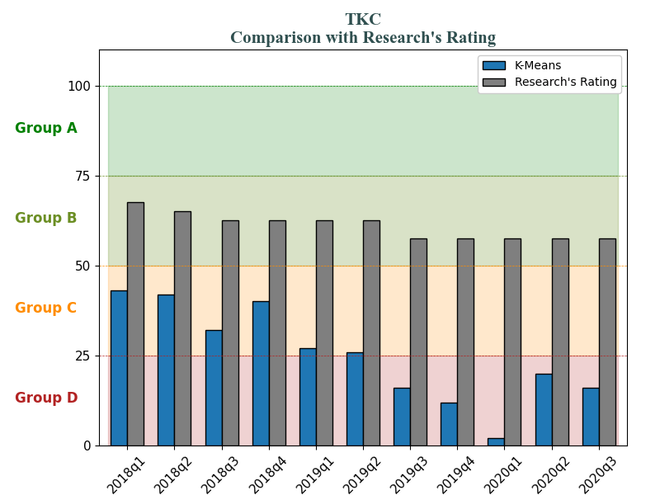
TKC dropped 85% in 2019q4

Slide 10
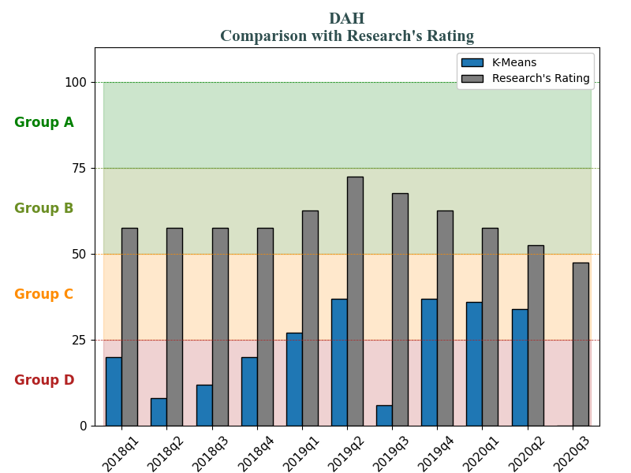
DAH dropped 80% in 2020q3

Slide 11
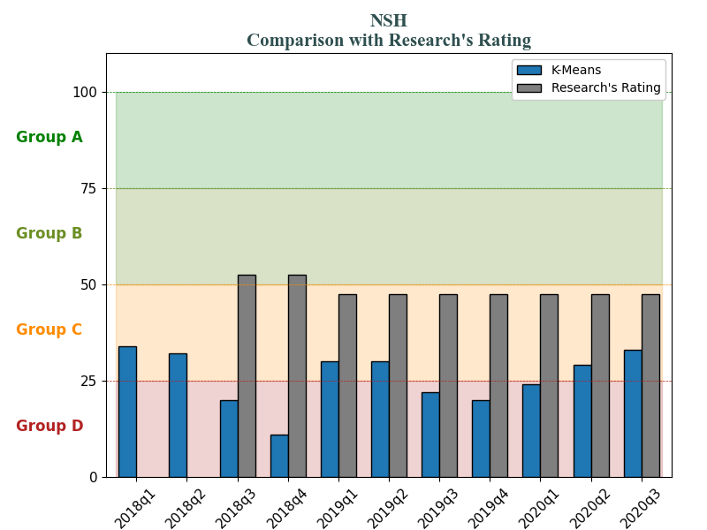
NSH dropped 80% in 2018q4

